Slide 1
SysAdmin - Weekly Operational Review
21st Oct’26
Period: 10th – 16th Oct’26

Slide 2
Agenda
01
Executive Summary
02
SJC – Overall Case Volumetric & Analysis
03
Case Volumetric for Realigned SJC - Buildings
04
SLA Metrics
05
Accolades

Slide 3
Executive Summary
Operational Updates:
Overall, 127 cases were handled by the Cognizant Team at the SJC location
Of the 127 total cases, Offshore team managed 50% (64 cases), while the Onsite team handled remaining cases
The offshore team handled 64 total cases: of which majority were related to OS installation & troubleshooting
The onshore team handled 63 total cases: of which majority were related to the SJC01 & 15 power outage & few Network related issues where there is manual intervention needed
SJC01 and SJC15 power outage – Power was restored to the buildings; however, a few hosts and testbeds remained in a hung state or failed to come online. The onsite and offshore teams have collaboratively worked to troubleshoot and resolve these issues
The offshore team coordinated with the triaging team for 54 cases, helping them to reassign to Lab Staff as follows:
  Hands and Feet (37 cases): 27% (10 cases) were reassigned from lab staff to SysAdmin
  Network & Hardware Troubleshooting (17 cases): Assigned to SysAdmin onshore as physical intervention was in need
Average CSAT score feedback received for 11% ( 7 cases ) of the total cases handled by Offshore team and the score is 5/5

Slide 4

SJC – Overall Case Volumetric & Analysis:
Period | Offshore | Onshore | Total Offshore & Onshore | Triaged Cases
4th Week of Sep | 50 (56%) | 39 (44%) | 89 | 229
5th Week of Sep | 47 (52%) | 43 (48%) | 90 | 281
Previous Week | 41 (51%) | 39 (49%) | 80 | 278
Current Week | 64(50%) | 63 (50%) | 127 | 311

Slide 5
SJC – Case Volumetric For Realigned Buildings
 | 5th Week Of Sep |  | Previous Week |  | Current Week
Building | Offshore | Onshore | Offshore | Onshore | Offshore | Onshore
SJC01 & 02 | 2 | 4 | 5 | 9 | 7 | 25
SJC12, SJC13 SJC15 | 6 | 9 | 5 | 3 | 15 | 10
SJC21 | 0 | 0 | 0 | 0 | 1 | 0
SJC22 | 4 | 0 | 1 | 0 | 0 | 0
SJC 23 & 24 | 2 | 6 | 2 | 2 | 3 | 4
SJC16 | 0 | 2 | 1 | 0 | 2 | 2
SJC03 & 04 | 9 | 0 | 10 | 0 | 5 | 0
SJC20 | 7 | 12 | 6 | 8 | 5 | 9
Total | 30 | 33 | 30 | 22 | 38 | 50
Percentage | 48% | 52% | 58% | 42% | 43% | 57%
Offshore team has independently handled the cases from the realigned buildings
Due to unplanned power outages in SJC01 & 15 we have seen an increase in cases for these buildings

Slide 6
SLA Metrics SJC Location
Combined SLA (Offshore+Onshore)
MTTA
<1 Day MTTR
<=7 Day MTTR
CSAT
<4 Hrs.
70%
90%
4.9
Target
Target
Target
Target
22 mins
75%
100%
5
Average first response
Average time taken to resolve (closed within 1 workday)
Average time taken to resolve (closed within 1 work week)
Measure the CSAT for a specific case
on a 1-5 scale
Offshore SLA
<4 Hrs.
70%
90%
4.9
Target
Target
Target
Target
9 mins
84%
100%
5
63%
Average first response
Average time taken to resolve (closed within 1 workday)
Average time taken to resolve (closed within 1 work week)
Measure the CSAT for a specific case
on a 1-5 scale

Slide 7
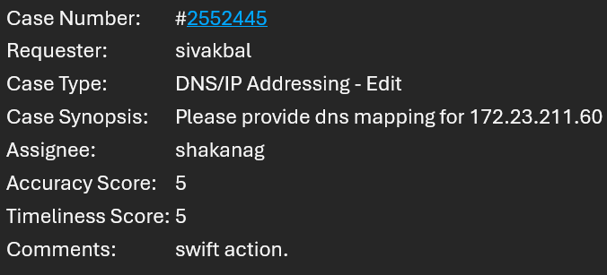
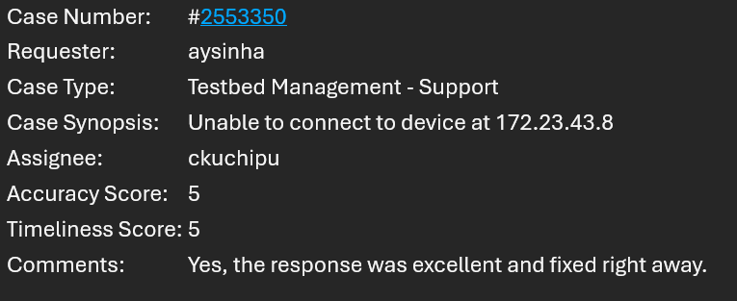
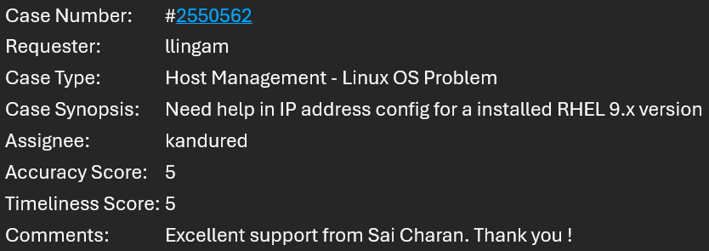
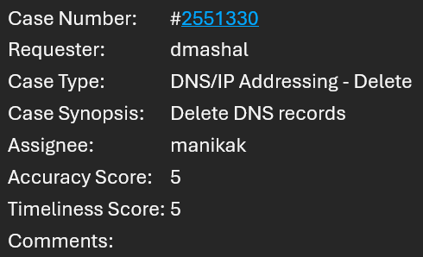
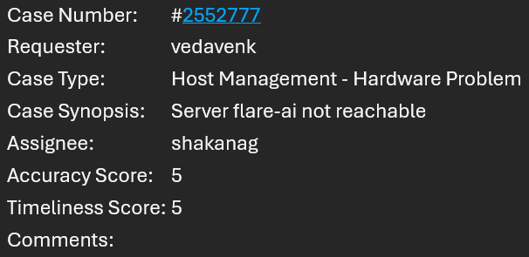
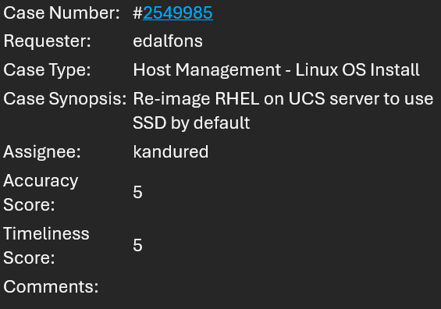
Accolades

Slide 8
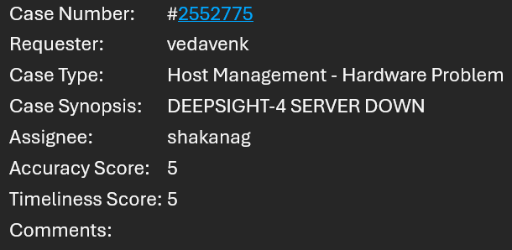
Accolades

Slide 9
Thank you

Slide 10
Cisco

Slide 11
Completed Actions from Previous Meeting
Date | Problem Statement | Owner | Update | Status
10-06-2026 | Plan cross-skilling for LabAdmin team along with Offshore Team | Offshore Team | Offshore team connected with Lab Admin leads regarding training plan Offshore team prepared Lab Admin Guide which has been reviewed by Calvin Calvin recommended to add configuration for APC & Enlogic PDU model types The Lab Admin Guide has been reviewed by Onsite SysAdmin & Calvin Lab Admin Training Overview (Offshore SysAdmin) Hands-on session for Lab Admins – PDU configuration training for lab staff scheduled on 31st Aug Enlogic PDU hands on document shared with Lab Admins | Completed
17-09-2026 | Demo of MTTR calculation | Offshore Team | Calvin requested demo of MTTR calculation done by SysAdmin team MTTR calculation demonstrated in last week’s connect | Closed

